Slide 1


Making Health Economic Evaluation Shiny: A tutorial
Robert Smith^{1,2,3}, Paul Schneider^{1,2} & Sarah Bates^{1,2}
School of Health and Related Research, University of Sheffield, UK.
Dark Peak Analytics Ltd, Sheffield, UK
Joint Biosecurity Center, Department of Health and Social Care
Course created for: Costello Medical - February 2021.

Slide 2
Course Timeline
Date | Section | Comments
15 Feb 2021 | Introductions Partitioned Survival Models | Introductions, agenda, accessing course material. Partitioned survival models in R. R skills: Custom functions & loops Project Management: GitHub, new project.
18 Feb 2021 | Markov models in R Functionizing markov models | A simple health economic markov model in R. R Skills: Matrix Multiplication, PSA, R-packages.
22 Feb 2021 | Intro to R Shiny User Interface Design | R Skills: R-Shiny, UI design: in HTML & CSS.
24 Feb 2021 | Integrating HE & Advanced R-Shiny Workflow | Health Economic Evaluation - Markov Models R Skills: R-Shiny, deploying R-Shiny app. Project management: Workflow & Git.
https://www.urbandictionary.com/define.php?term=functionize

Slide 3
SESSION 1
15th February 2021
Date | Section | Comments
Part 1 | Introductions & Background | Introductions & background Why health economics is shifting toward script based models. Accessing course materials Project management & Github
Part 2 | R skills: Custom functions For loops Exercises | Short skills session to ensure that participants have the necessary knowledge to complete the PSM section.
Part 3 | Partitioned Survival Models | Longer session on PSM in R.
Recap | Questions & discussion | Recap and discussion.

Slide 4
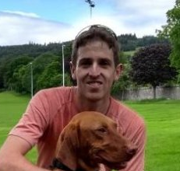
Robert Smith
Background:
Bachelors & Masters in Economics from the University of Nottingham.
PhD Candidate, School of Health & Related Research, Sheffield.
Expert Advisor, WHO-HEAT for Walking & Cycling.
Advanced Analytics, Joint Biosecurity Centre (DHSC)
Teaching:
Advanced Simulation Methods (ScHARR HEDM MSc)
Medical Statistics (Sheffield Medical School)
Short course series - ‘R’ for health economics & decision science.
Research:
Health economics & data science for Public Health.
Development of user interfaces for health economic models.

Slide 5

Paul Schneider
Background:
MD + DrMed, University of Witten/Herdecke, Germany
MSc Health Science Research MSc, Maastricht University, the Netherlands
PhD Candidate, School of Health & Related Research, Sheffield.
Teaching:
Introduction to R
Causal Inference in RWD and Clinical Trials
R-Shiny for health economic evaluation
Research:
Empirical and theoretical issues in the valuation of health and economic evaluations
Open Science

Slide 6

Sarah Bates
Background:
BSc (Hons) Psychology, University of Surrey.
MSc Health Psychology, King College London
PhD Candidate, School of Health & Related Research, Sheffield.
Teaching:
Medical statistics (Medical school)
Valuing the benefits of Healthcare (ScHARR HEDM MSc)
Supervisor on SURE scheme
Health Technology Assessment (ScHARR open access courses)
Research:
Feasibility of including psychological factors in health economic modelling of behavioural weight management interventions.

Slide 7

Participants
What your background is…
Previous experience with R …
Your aims from this course…

Slide 8
HOUSEKEEPING

Slide 9
Housekeeping
Feel free to use the feedback buttons.
If you have a question please raise your hand.
If you want me to speed up/slow down let me know.

Slide 10
Housekeeping (2)
Course materials including presentations, course manual, example scripts and exercises are provided online here: https://github.com/bitowaqr/emsr_course
A course book is also available online: https://bitowaqr.github.io/emsr_course/
We will work through scripts describing what is happening.
Short Session: Use of GitHub & Course material access.

Slide 11

Housekeeping (3)

Slide 12
BACKGROUND

Slide 13
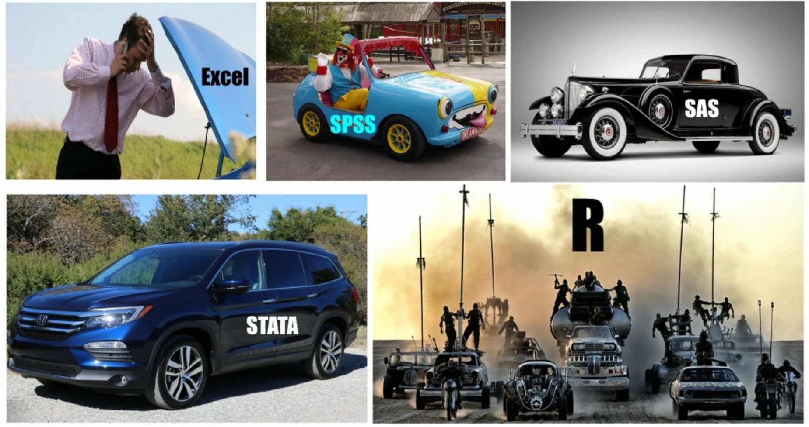

Slide 14
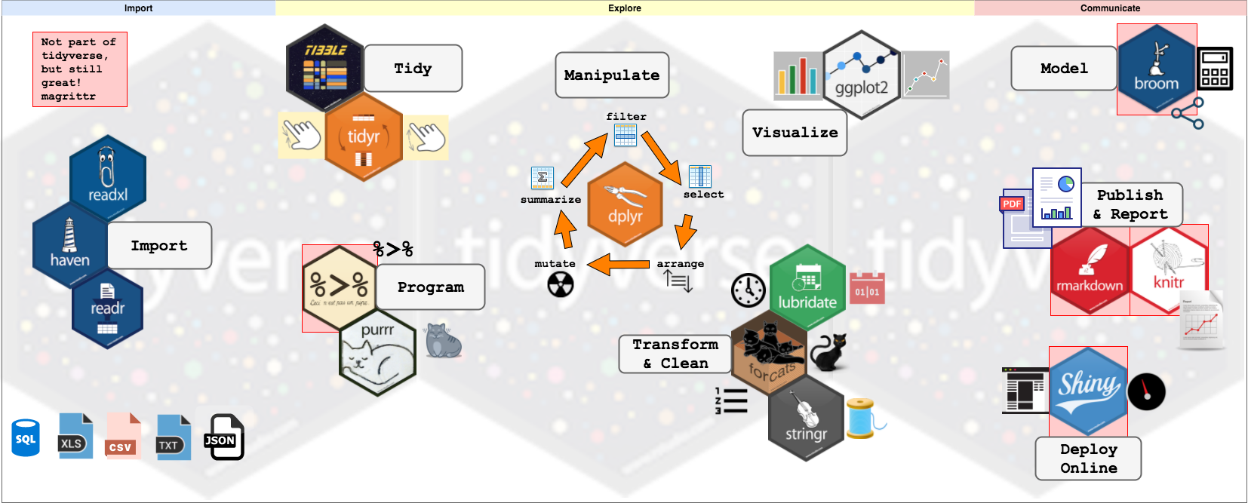

Slide 15

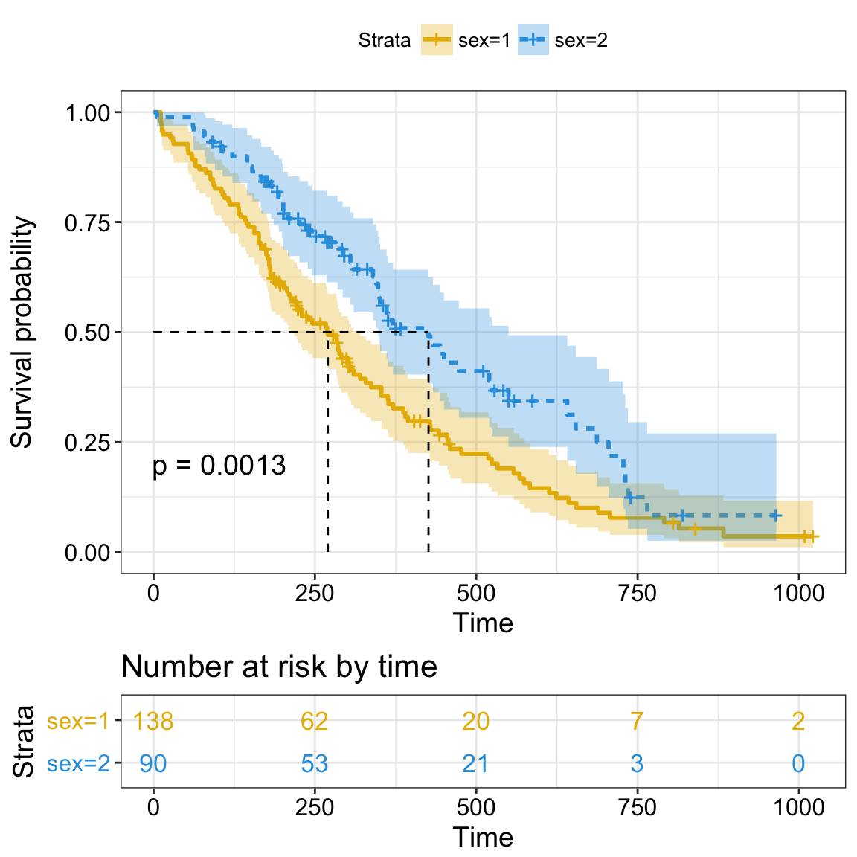

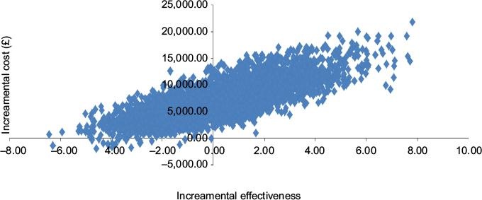

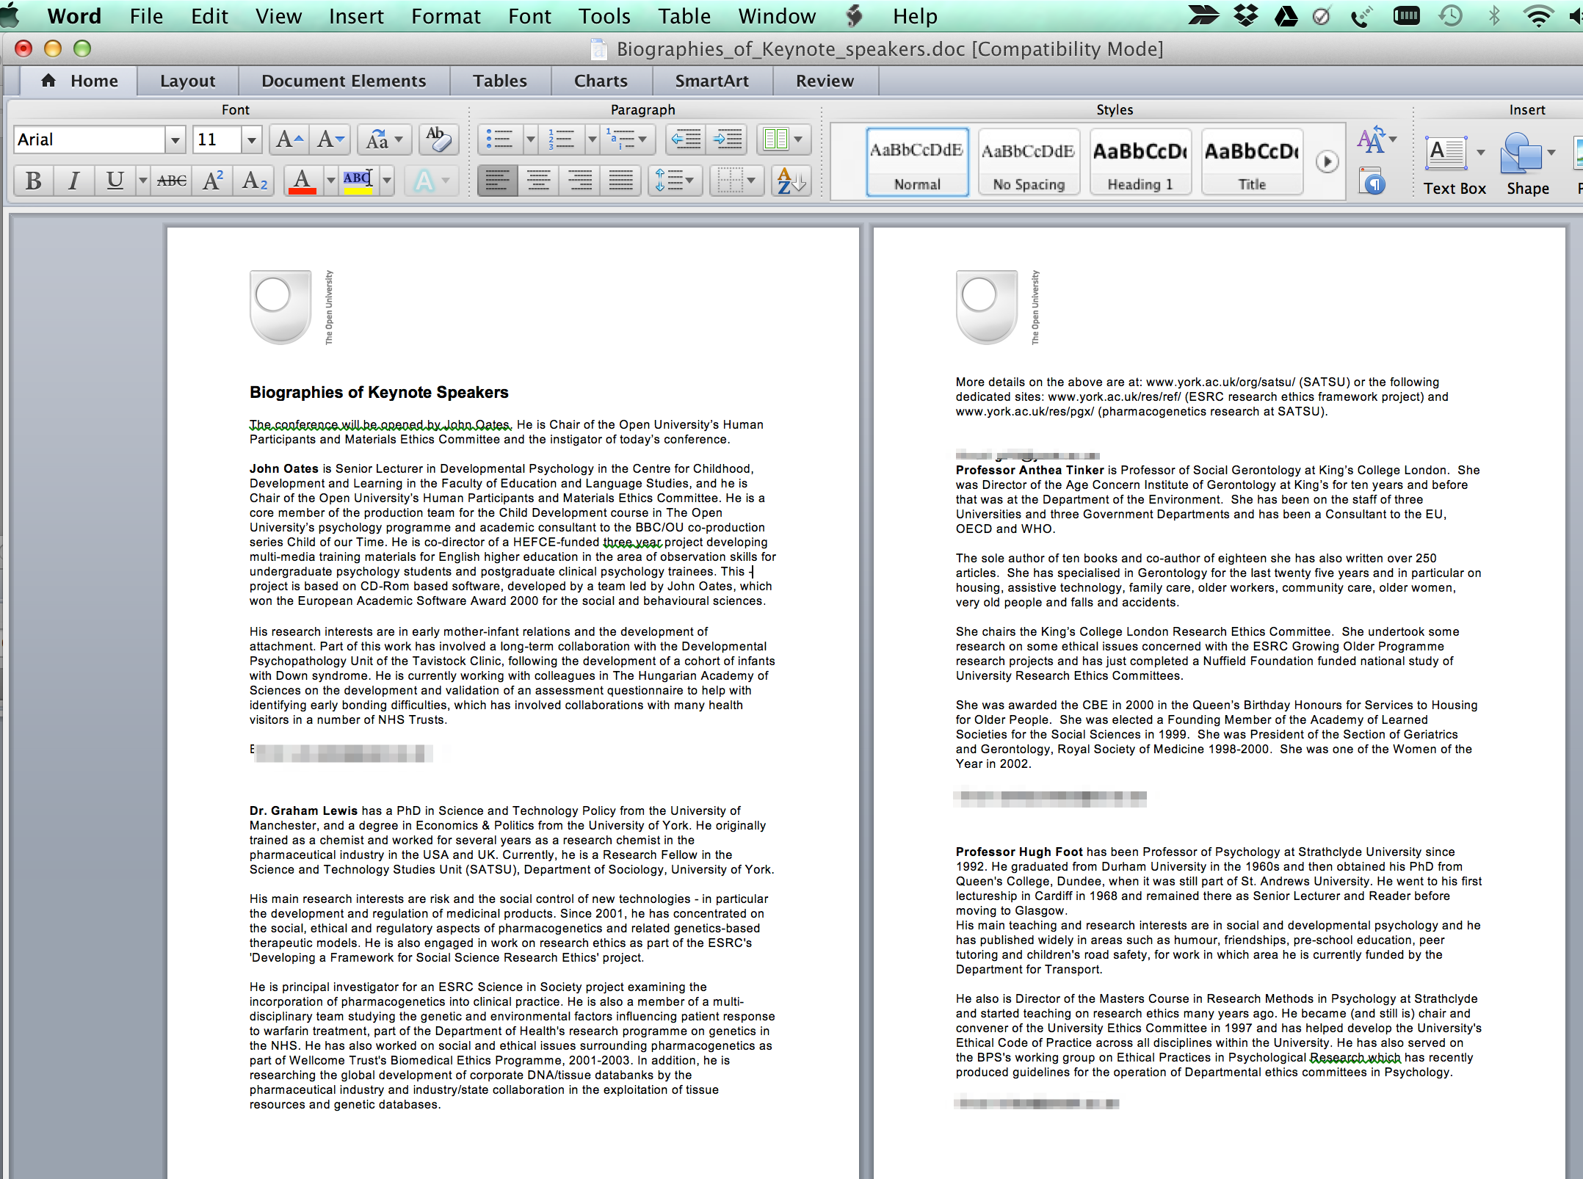



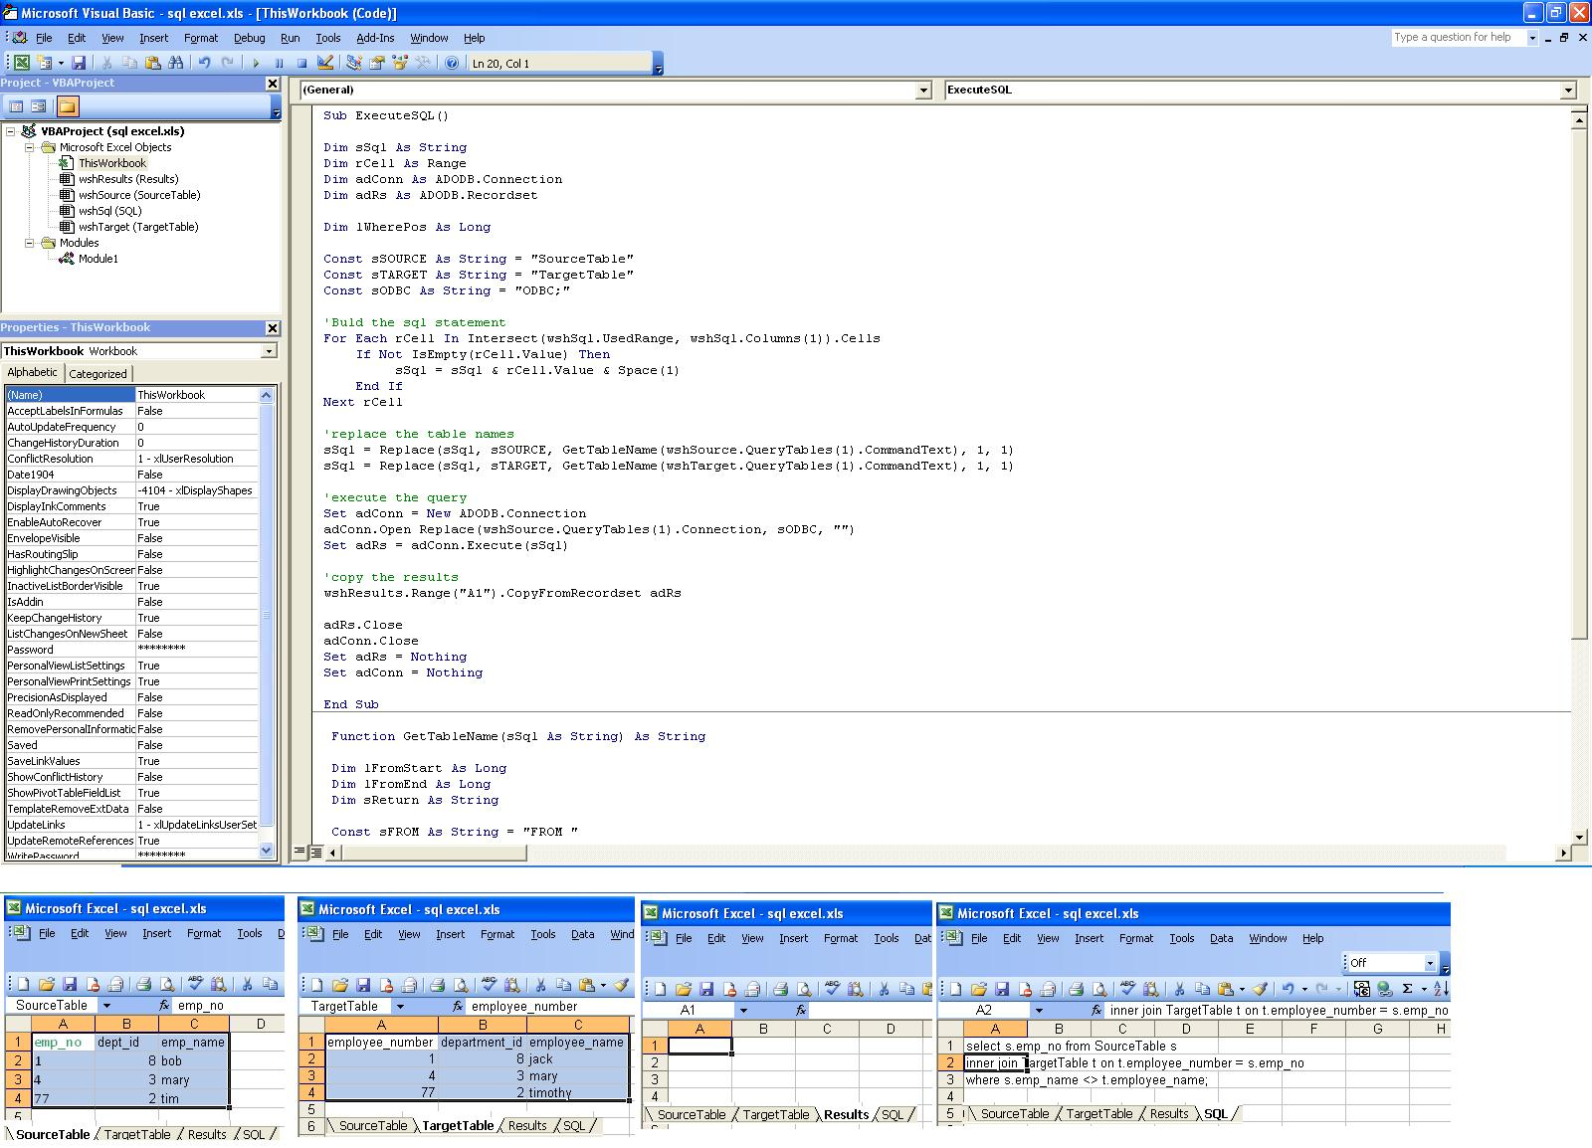
Why use R for decision modelling?
Output
Model
Input
Plots
Present

Slide 16






Why use R for decision modelling?
Model
Output
Input
Plots
Present

Slide 17













External Data
Manager
Economist
LaTeX editor
Publication
Secure Data
Static Repository
Combine workstreams using GitHub.
Statistician
User Interface

Slide 18




Link to graph gallery
Course Document
Example Shiny App
Course GitHub Link

Slide 19
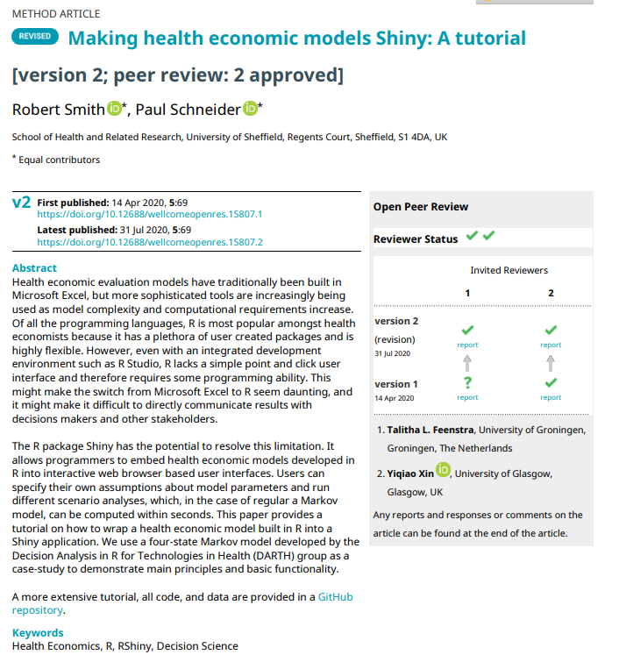
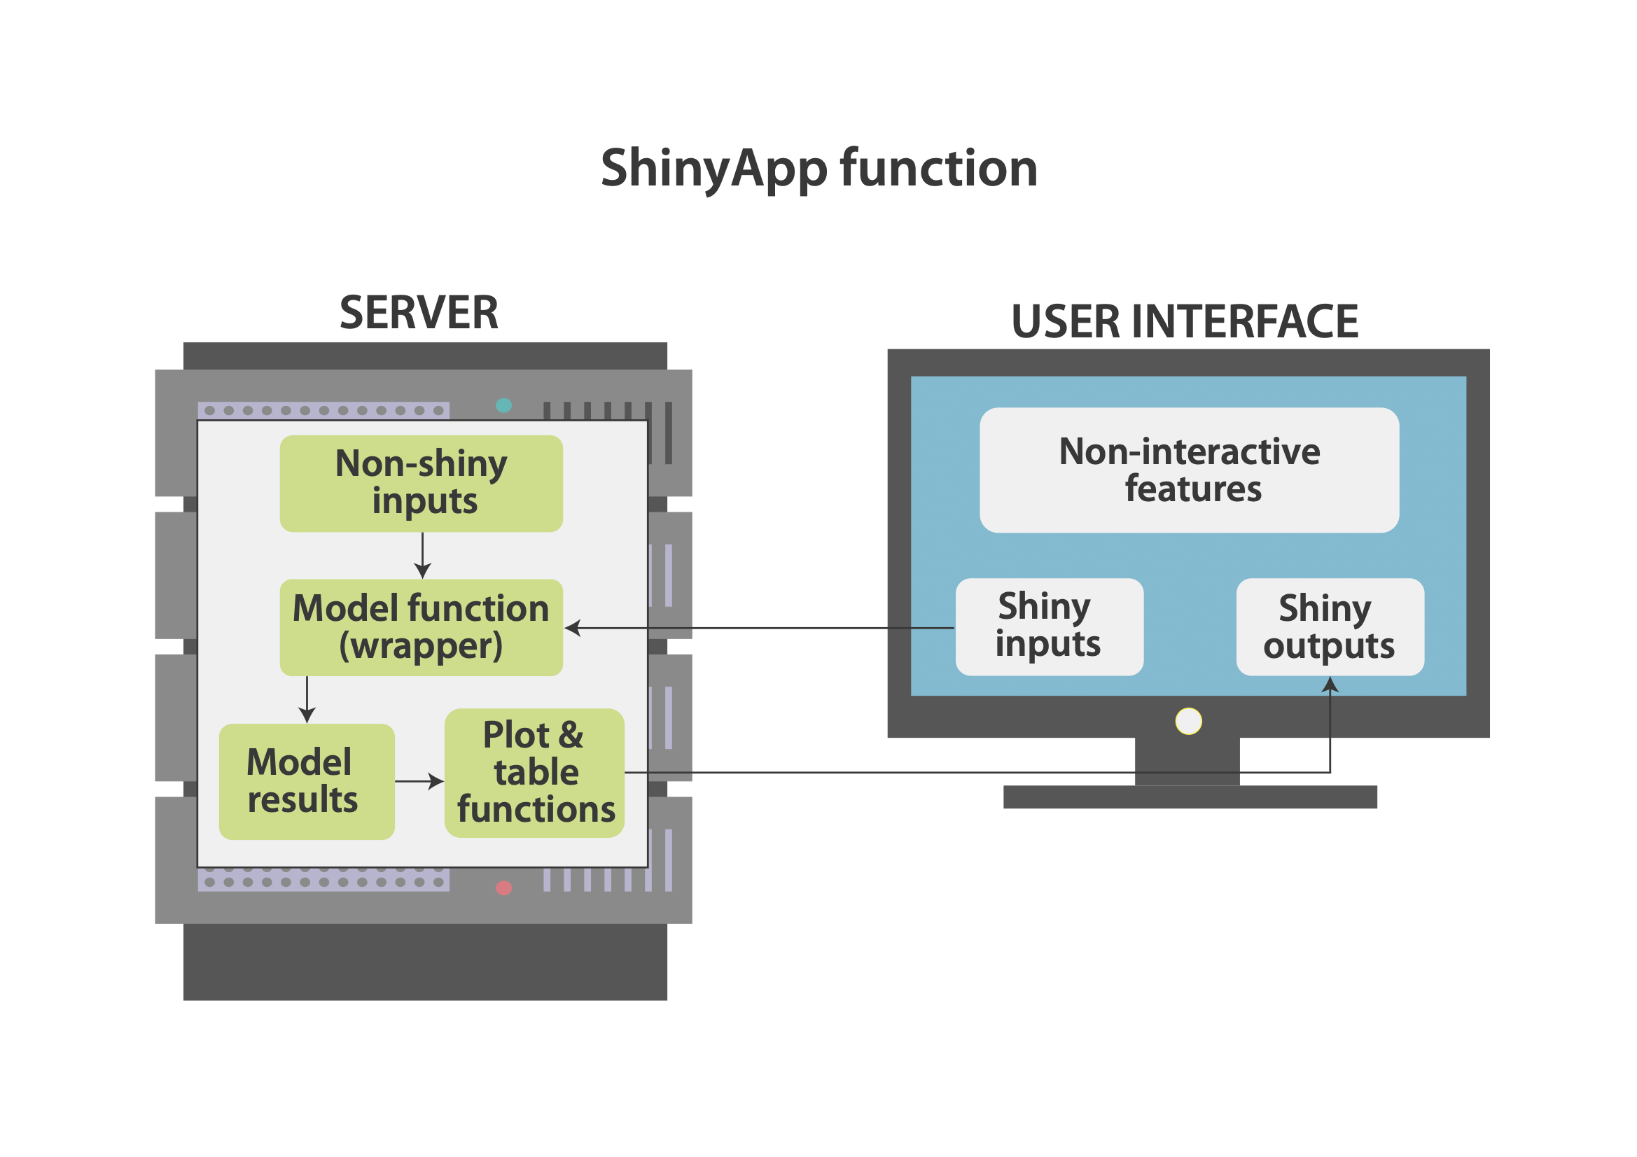
Publication
https://github.com/RobertASmith/paper_makeHEshiny
https://robertasmith.shinyapps.io/sick_sicker
https://darkpeakanalytics.shinyapps.io/heRvis/

Slide 20

For loops & custom functions

Slide 21
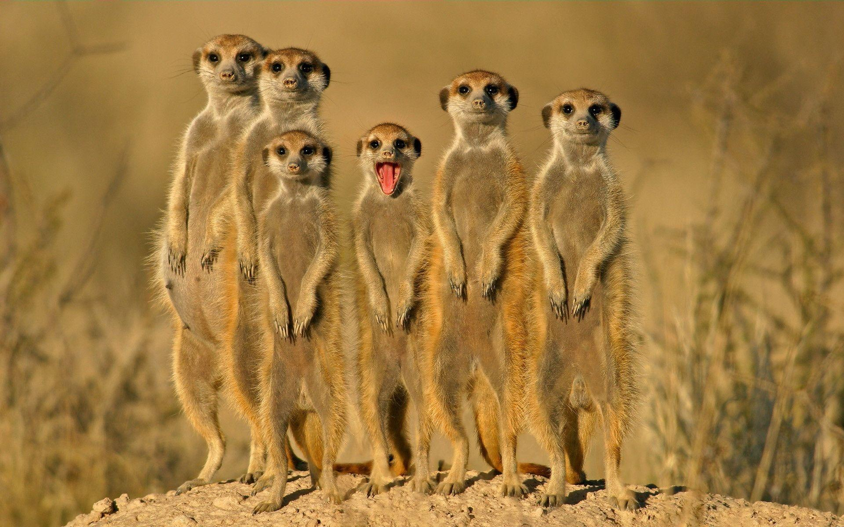
BREAK

Slide 22
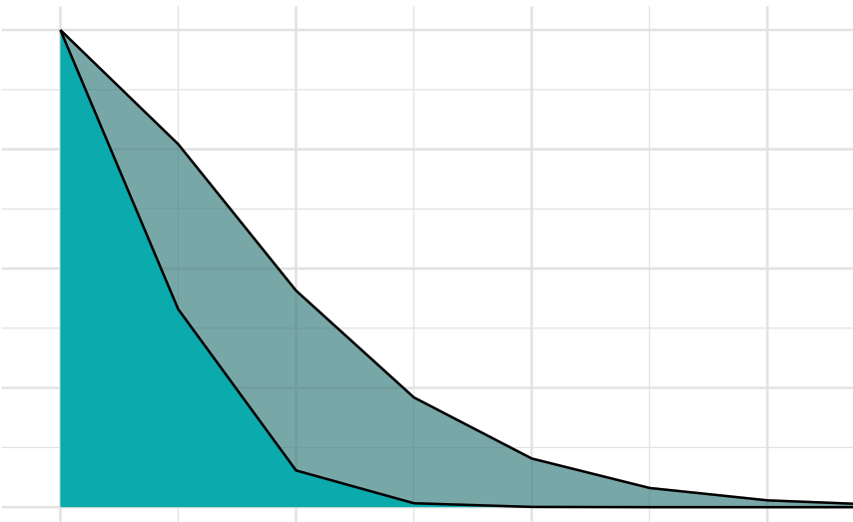
PARTITIONED SURVIVAL MODELS

Slide 23
Objectives
Understand how to structure a project in R
Be able to utilise for loops and build custom functions in R
Develop a deterministic partitioned survival model

Slide 24
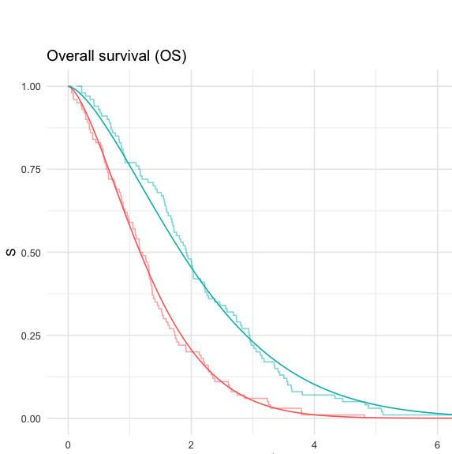
Model description
Supimab versus Standard Of Care (SOC)
3-state model: PFS, PPS, Dead
Patients in PFS receive either Supimab or SOC
After disease progression they stop treatment
We will start with IPD
Horizon: 10 years
Time steps: 1 year

Slide 25
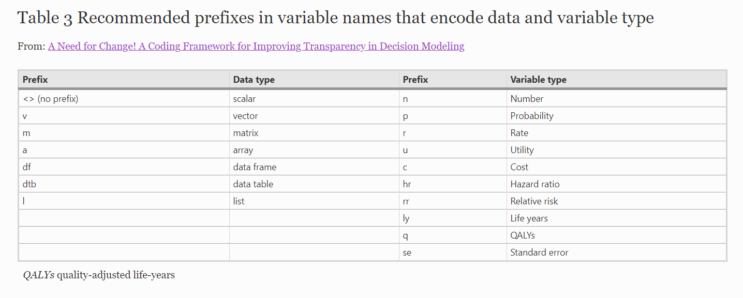
Coding Framework

Slide 26
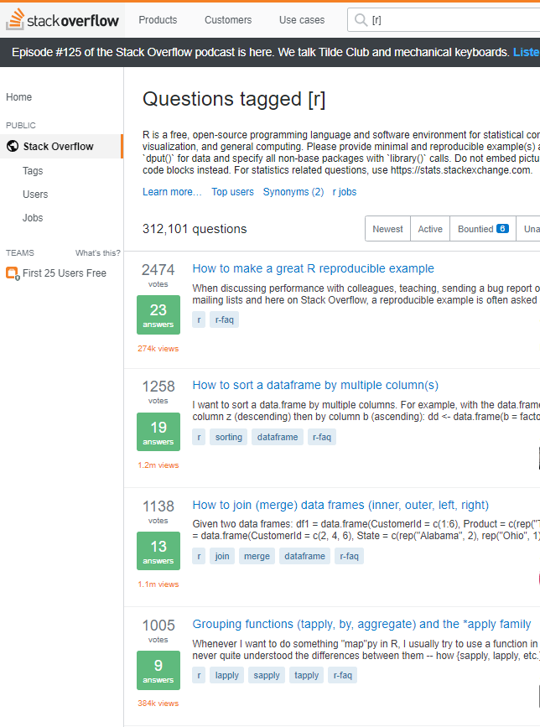
Getting help & tips
R’s vignettes are very helpful. Type ?matrix to get help on matrices.
If you are not sure on the exact function name type apropos() then something close to the function name in quotation marks, e.g. apropos(“mean”) gives:
[1] ".colMeans" ".rowMeans" "colMeans" "kmeans"
[5] "mean" "mean.Date" "mean.default" "mean.difftime"
[9] "mean.POSIXct" "mean.POSIXlt" "rowMeans" "weighted.mean"
Google it: 1) Stackoverflow, 2) StackExchange, 3) RBloggers
Copy-Paste
Multiple cursor selection (CTRL + ALT) can be useful.

Slide 28

BREAK

Slide 29
EXERCISES

Slide 30
Session 1: Recap

Slide 31
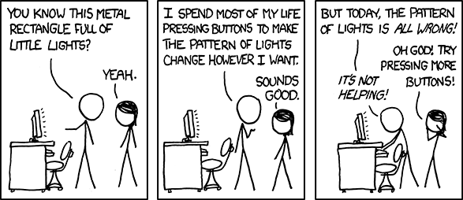

Slide 32
Further resources
https://github.com/Health-Economics-in-R/existing_health_economics_packages
Incerti, D., Thom, H., Baio, G. and Jansen, J.P., 2019. R you still using Excel? the advantages of modern software tools for health technology assessment. Value in Health, 22(5), pp.575-579.
Baio, G. and Heath, A., 2017. When simple becomes complicated: why excel should lose its place at the top table.
Hart, R., Burns, D., Ramaekers, B., Ren, S., Gladwell, D., Sullivan, W., Davison, N., Saunders, O., Sly, I., Cain, T. and Lee, D., 2020. R and Shiny for Cost-Effectiveness Analyses: Why and When? A Hypothetical Case Study. PharmacoEconomics, 38(7), pp.765-776.
Hatswell AJ, Chandler F: Sharing is caring: the case for company-level collaboration in pharmacoeconomic modelling. Pharmacoeconomics. 2017; 35(8): 755–757.
Jansen JP, Incerti D, Linthicum MT: Developing Open-Source Models for the US Health System: Practical Experiences and Challenges to Date with the Open-Source Value Project. Pharmacoeconomics. 2019; 37(11): 1313–1320.
Jalal H, Pechlivanoglou P, Krijkamp E, et al.: An Overview of R in Health Decision Sciences. Med Decis Making. 2017; 37(7): 735–746.

Slide 33
SESSION 2
18th February 2021

Slide 34
SESSION 2
18th February 2021
Date | Section | Comments
Part 1 | Recap from Session 1 | Any questions Partitioned Survival Models with different distributions
Part 2 | R skills | Matrix multiplication example
Part 3 | Markov model | Step through Sick sicker Markov model Create simple markov model PSA
Recap | Questions & discussion | Recap and discussion.

Slide 35
Quick recap
Partitioned Survival Models with different distributions
Example Shiny App

Slide 36
Session 2: Objectives
Understand the functions needed to build a simple Markov model
Matrix multiplication
Generating data frame for PSA
Understand and apply matrix multiplication to speed up a Markov model.
Implement probabilistic sensitivity analysis (PSA).
Create a ‘wrapper’ function which will facilitate the development of the R shiny app

Slide 37
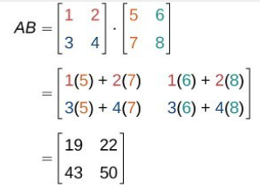
Matrix multiplication (1)

Slide 38
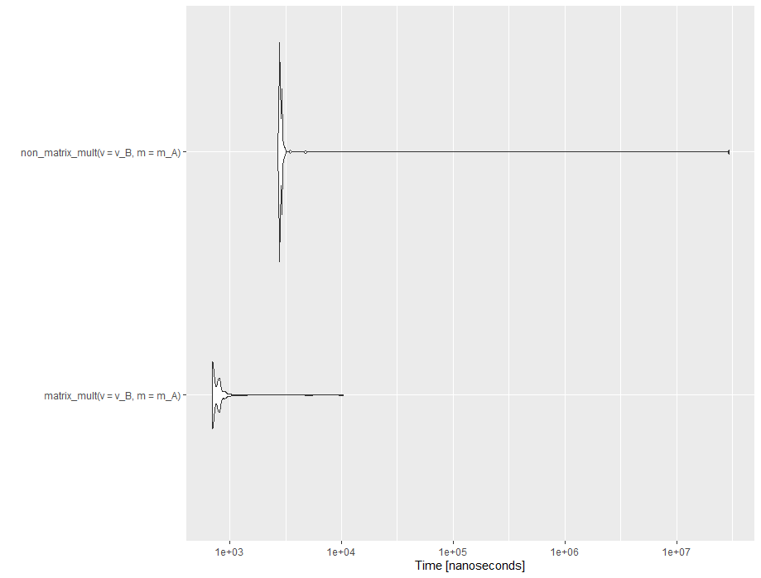
Matrix multiplication (2)
Log scale

Slide 39
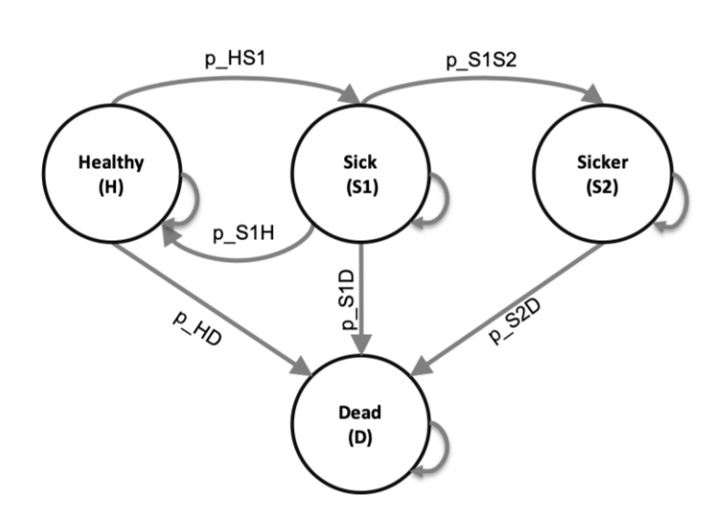

Sick, sicker Markov model
https://github.com/DARTH-git
https://darthworkgroup.com/

Slide 40
Exercise: Matrix Multiplication
1. Initialize the first period of the Markov Trace. (100% of the population starts Healthy).
2. Use matrix multiplication to multiply the first row of the Markov Trace (m_T) by the Transition prob Matrix (m_P) and store the resulting values in the second row of the Markov Trace.
3. Use the for-loop function to repeat this process until the matrix is fully populated.
Extension 1. Wrap this whole process into a function that takes as arguments:
1) an initialized Markov Trace.
2) transition Matrix
Extension 2. Think about the limitations of this method:
1) what does it assume about the probability of transition between health states?
2) how could this limitation be overcome?
3) can you think of any way to speed up this further?

Slide 42
Session 2: Recap so far
Input parameters
Transition matrix
Markov trace matrix
For loop function
Matrix multiplication

Slide 43
Exercise: Outputs
Use the model to estimate cost-effectiveness of the treatment:
Create vectors for the costs and utility
Estimate mean costs and QALYs for each year
If you didn’t in the part B, apply discount weights (hint: need to use transpose function t() and matrix multiplication)
Create results table

Slide 44

BREAK

Slide 45
Probabilistic sensitivity analysis and wrapper function

Slide 46
SESSION 3
22nd February 2021

Slide 47
SESSION 3
22nd February 2021
Date | Section | Comments
Part 1 | Recap from Session 2 | Any questions from last session. Package validation
Part 2 | Presentation - why R-Shiny | Showcasing different shiny apps and their uses.
Part 3 | Introduction to R-Shiny | How does Shiny work. Building a simple shiny app.
Part 4 | Markov Model in R-Shiny | Integrating the sick-sicker markov model into our shiny app.
Recap | Questions & discussion | Recap and discussion.

Slide 48
Date | Section | Comments
Part 1 20mins 8:50 | Recap from Session 2 | Any questions from last session. Package validation
Part 2 15 mins 9:05 | Presentation - why R-Shiny | Showcasing different shiny apps and their uses.
Part 3 30 mins 9:35 | Introduction to R-Shiny | How does Shiny work. Script 1 - “hello” Exercise 1 Script 2 - “numeric input” Exercise 2
Break 10mins | Break | Break
Part 4 - 60 mins 10:45 | Introduction to R-Shiny | Script 3 & 4 Exercise 3 - Action button and sidebar layout Discuss Exercise 3 Exercise 4 - UI design
Break 10mins | Break | Break
Part 5 - 35 mins 11:30 | Markov Model in R-Shiny | Integrating the sick-sicker markov model into our shiny app. Exercise 5 - sick-sicker integration.
 | Sign up to shinyApps | Sign up to shinyApps
Recap | Questions & discussion | Recap and discussion.

Slide 49
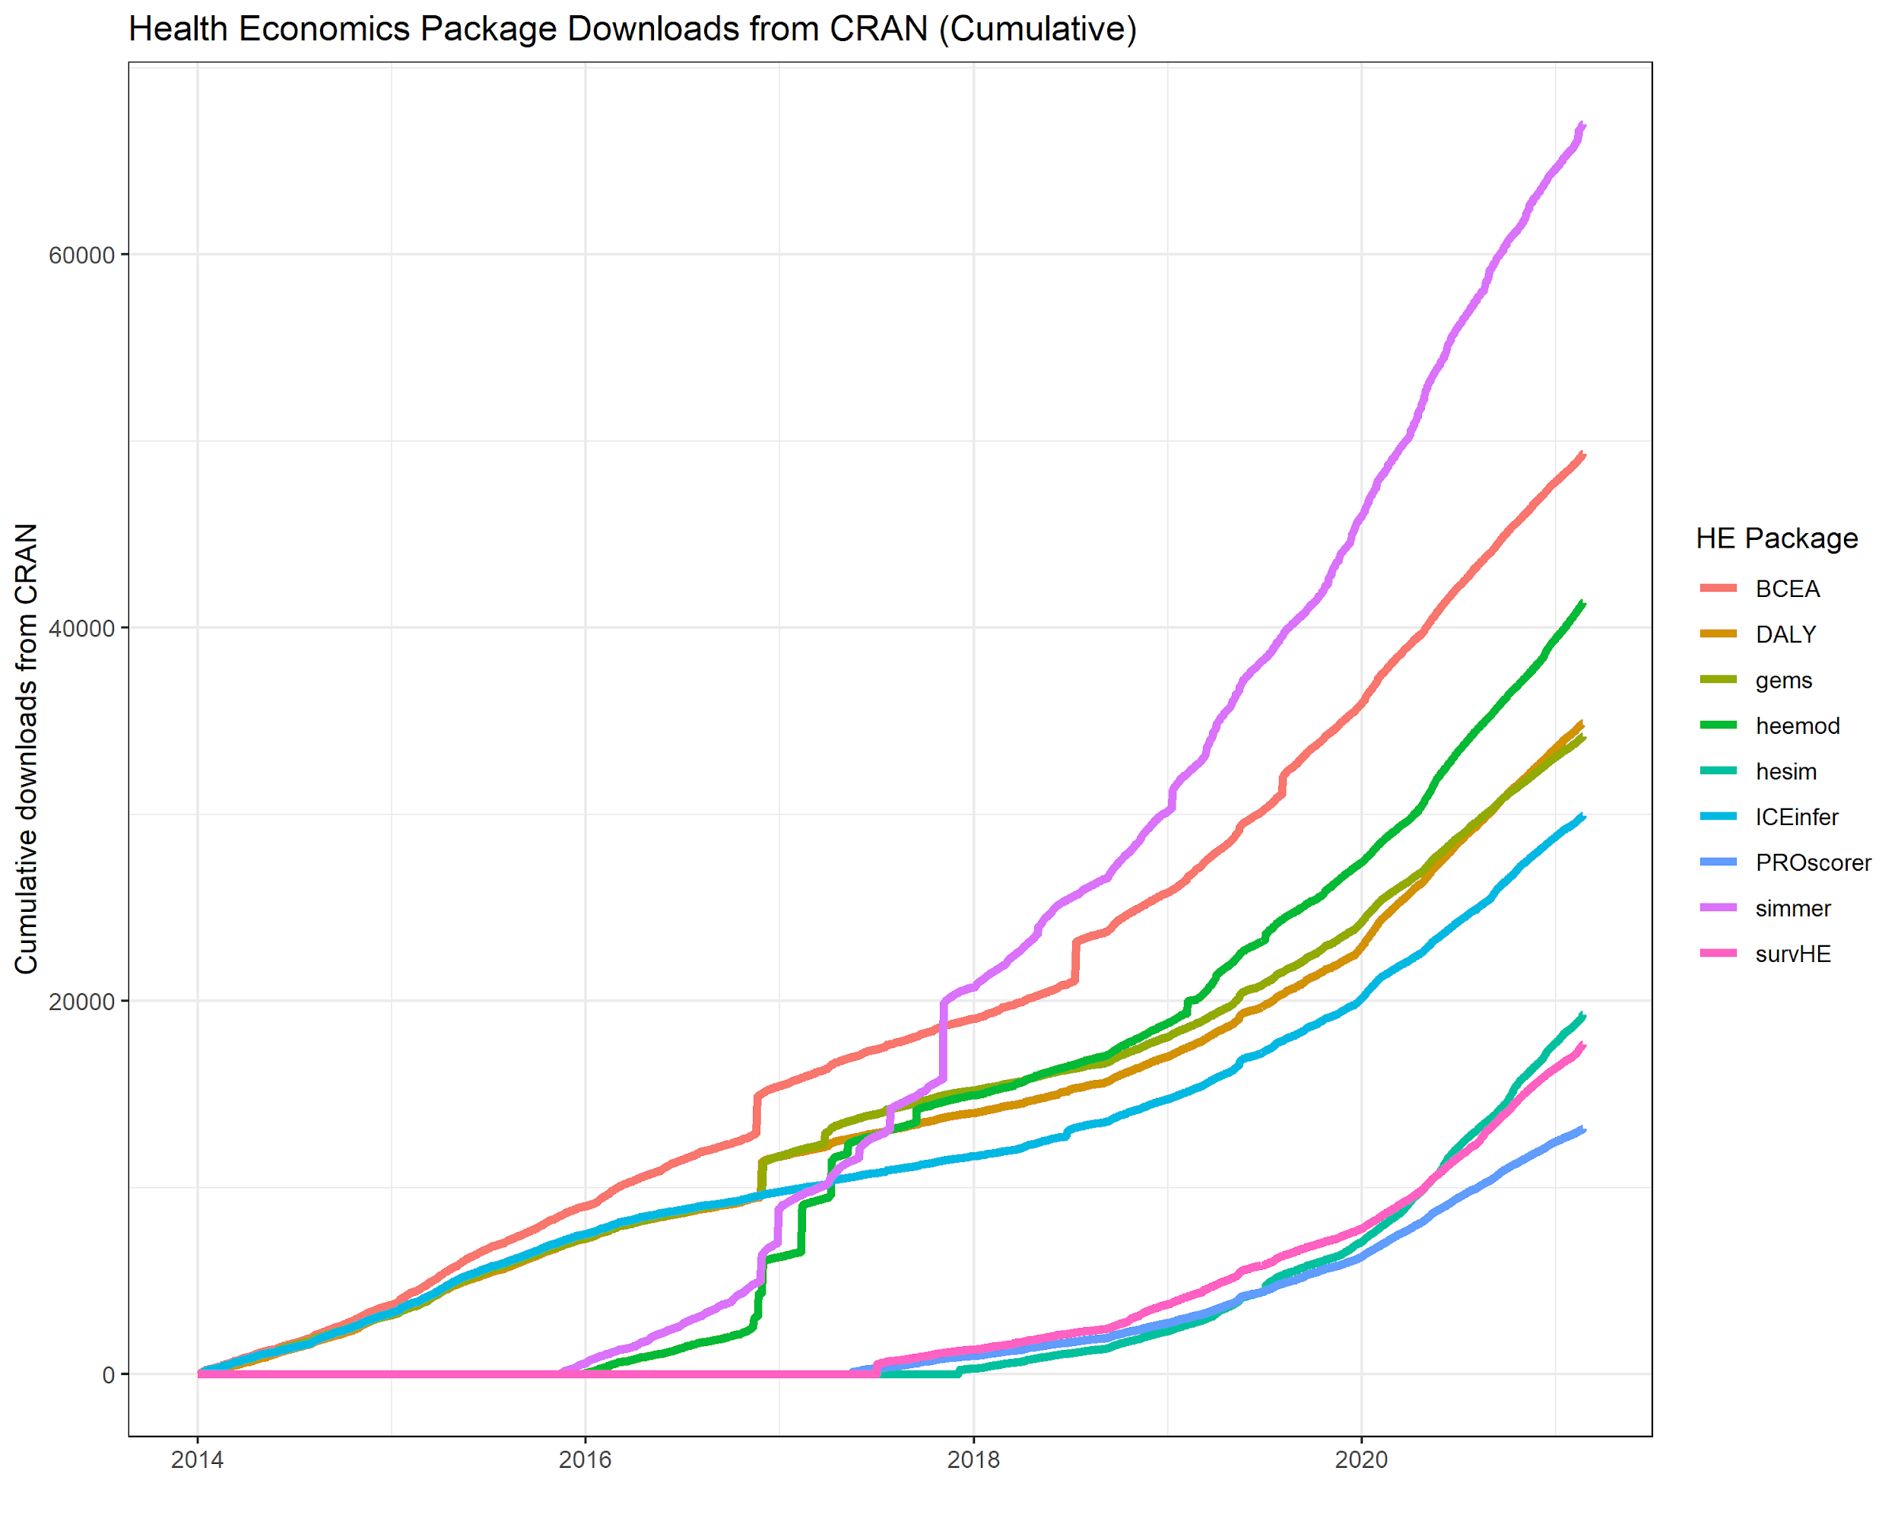
Downloads of some of the most popular packages
Some packages have been downloaded much more than others.
R is the not the only script based option (see Python).
https://github.com/pierucci/heemod/issues

Slide 50
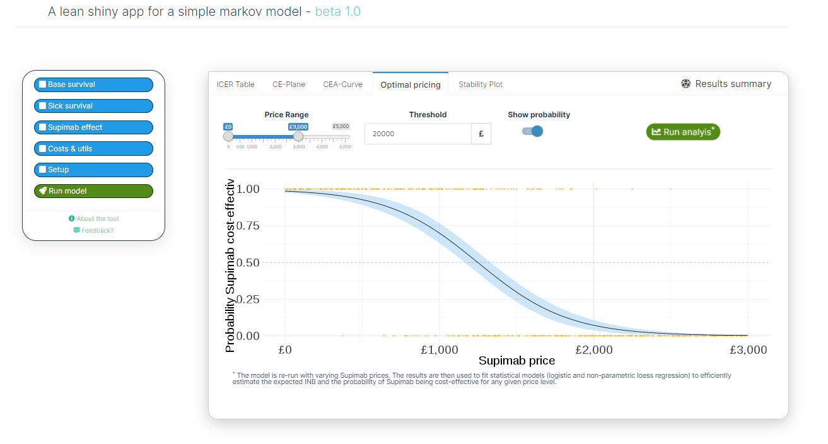
Example Shiny Apps
Gallery
Oxford
BresMed InteRface
WHO FGM
DarkPeak

Slide 51
Session 3: Objectives
Understand the user interface object and the server function
Build a basic R shiny app
Add inputs and outputs
Add an action button
Use functions within the app
Add a reactive plot to the outputs
Overarching target: Build a ‘bare bones’ R shiny app for the sick sicker markov model.

Slide 52
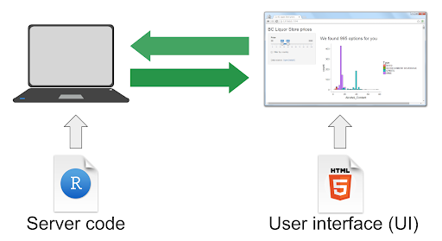
How does Shiny Work?

Slide 54
Exercises (1)
Create a new Shiny app that contains the text “Hello <your name>”.

Slide 56
Exercises (2)
Add a second numeric input, y, with initial value of 200 and a range of 0 - 400
Take the sum of x and y and show the result as as a text output.

Slide 57

BREAK

Slide 59
Exercises (3)
In the Sidebar Layout page add two inputs:
Slider input, z, with a initial value of 25 and a range on 10 - 80 (Hint: use the sliderInput function)
Action button which is referred to as: run_model .
b) Create a function in the server that calculates the difference between the maximum & mean of the three numbers (x, y, z) and returns a single number.
c) Output the result as a text output when the action button is pressed.

Slide 60
Exercises (4)
Customize your app and include a plot:
For example you may want to add:
A title
Add an explanation of the equations used in the function.
Add text to the sidebar panel.
To change the theme.
Add a scatter plot with the x input on the X axis and the y input on the Y axis. To do this you will need to use plotOutput() in the user interface function and renderPlot in the server function. (Hint, to create a simple scatter plot, use the plot() function, e.g. plot(x,y)
Notes:
Maybe reduce/remove the amount of exercises here and replace with exercises that build the app for the markov model?

Slide 61
Exercise answers

Slide 62
Recap of the sick, sicker model
Markov model with PSA functionality.
Wrapped in wrapper function.
Enables treatment cost, number of PSA iterations, and initial age to be altered.

Slide 63
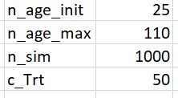
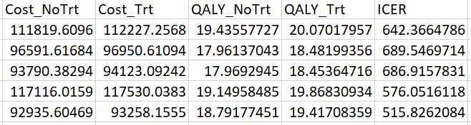
How did our wrapper function work?
f_wrapper
f_gen_psa(inputs)
f_MM_sicksicker(df_psa[i, ])
df_out

Slide 64
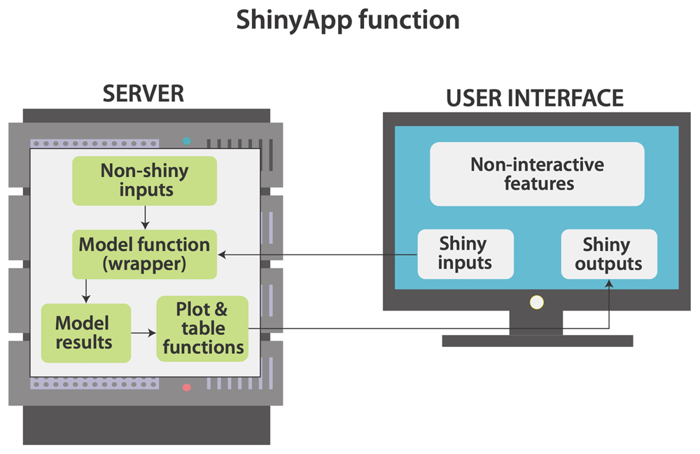
How does shiny work?
Smith R and Schneider P. Making health economic models Shiny: A tutorial. Wellcome Open Res 2020, 5:69 (https://doi.org/10.12688/wellcomeopenres.15807.2)

Slide 66
Integrating the Markov Model with R-Shiny
See Exercise 5 script:
Source the scripts that contain the model functions from the Markov Model/src folder.
Run model wrapper function (from within the run_model observe event function) with the inputs from the user interface and store the results as data-frame.
Calculate the ICER from the PSA outputs.
Display the ICER as a single text output using the renderText function.

Slide 68
Further resources
Tutorials and example code for basic shiny apps can be found in the link below:
https://shiny.rstudio.com/, https://shiny.rstudio.com/gallery/, https://shiny.rstudio.com/tutorial/, https://shiny.rstudio.com/images/shiny-cheatsheet.pdf
For more in-depth and advanced content see: https://mastering-shiny.org/
For the method of applying shiny to health economics see: Smith & Schneider (2020).
For specific R code styles see ‘Styler’: https://www.tidyverse.org/blog/2017/12/styler-1.0.0/

Slide 69
Session 3: Recap
Any questions/projects you would like to discuss next session?
We are happy to allocate some time to specific requests, in particular around collaboration & deployment.

Slide 70
SESSION 4
24th February 2021

Slide 71
SESSION 4
24nd February 2021
Date | Section | Comments
Part 1 | Recap from Session 3 | Any questions from last session. Time dependant transition probabilities Debugging
Part 2 | Visualising model outputs | Incorporating ggplot2 graphs into the app.
Part 3 | Reporting with RMarkdown | Dynamic reports that update automatically if parameter inputs change.
Part 4 | Customising R-Shiny | How does Shiny work. Building a simple shiny app. Warning modals
Part 5 | Deploying Apps Online | Moving your fancy apps online
Recap | Questions & discussion | Recap and discussion.

Slide 72
Recap
Wrapping up model into single function.
Creating a ‘bare-bones’ shiny app.
Additional material before session based on requests:
Time varying Markov Model
Debugging
EVPI

Slide 73
SESSION 4
Date | Section | Comments
Part 1 (15mins) | Recap from Session 3 | Any questions from last session. Time dependant transition probabilities debugging
Part 2 (40mins) | Visualisation | Incorporating ggplot2 graphs into the app. Exercise
Break (9:25)
Part 3 (40mins) | Reporting with RMarkdown | Dynamic reports that update automatically if parameter inputs change. Exercise
Break (10:10)
Part 4 (45mins) | Customising R-Shiny | How does Shiny work. Building a simple shiny app. Warning modals Exercise
Break (11:00)
Part 5 (25mins) | Deploying Apps Online | Deploying your fancy apps online
Recap (30mins) | Questions & discussion | Recap and discussion on any material.

Slide 74
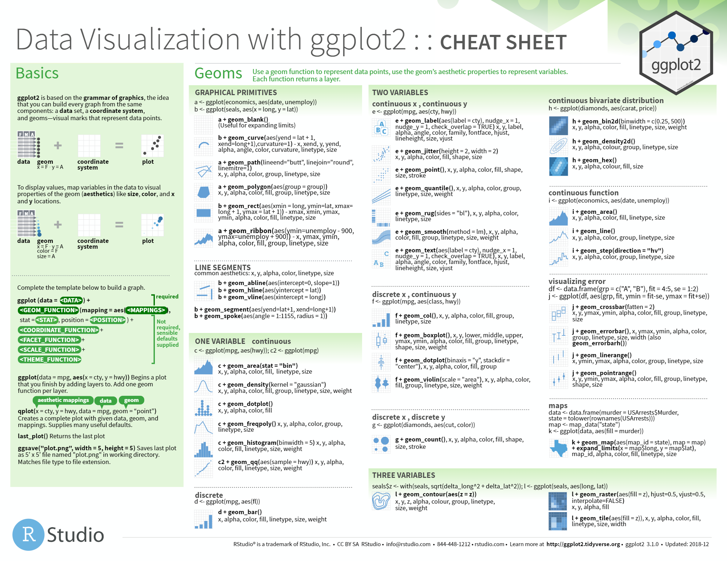
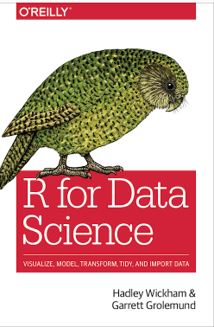
Visualisation
https://github.com/rstudio/cheatsheets/blob/master/data-visualization-2.1.pdf
https://r4ds.had.co.nz/index.html

Slide 75


Slide 76
Exercises
1. Run the wrapper function to create a set of results.
2. Create a simple scatter plot using ggplot2 that has inc_Q on the x axis and inc_C on the y axis and each point representing an iteration.
3. Insert a large red point to represent the mean Costs & QALYs
4. Add a Title, Subtitle, x axis title and y axis title
5. Review the following function, can you quickly change the theme to be theme_dark?
6. A last minute change to the price of the treatment has been announced. Run the model with c_Trt = 100 and plot the results
Extension: Add these fancy plots in to your app instead of the simple plot you had last time.

Slide 77
BREAK

Slide 78
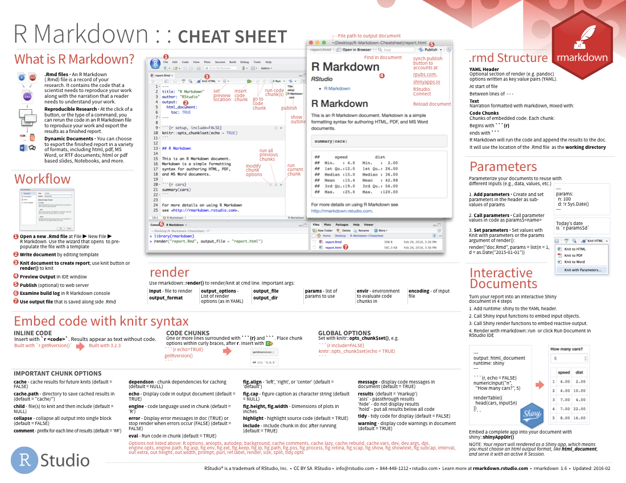

R-Markdown
https://rmarkdown.rstudio.com/lesson-15.html
https://bookdown.org/yihui/rmarkdown/

Slide 80
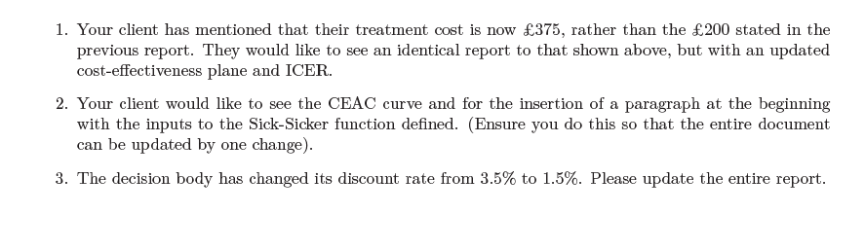
Exercises

Slide 81
BREAK

Slide 82
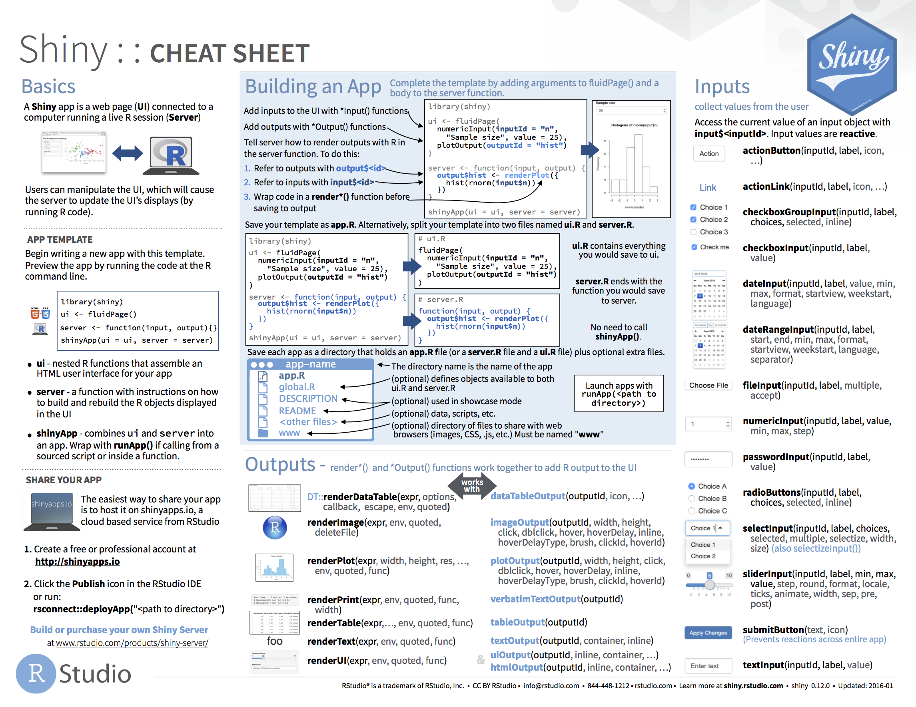

Customising R-Shiny
https://shiny.rstudio.com/articles/cheatsheet.html
https://mastering-shiny.org/

Slide 84
Exercises
1. Use the CEP and CEAC functions we created in the previous session to make fancy plots in this app.
Extensions:
Put these plots in tabs so the app looks tidier. Tabsets tutorial
Change the option to select PSA runs to be a dropdown (selectInput).
Change the runModel button so that it says the number of simulations that will be run MasteringShiny simple

Slide 85
BREAK

Slide 86
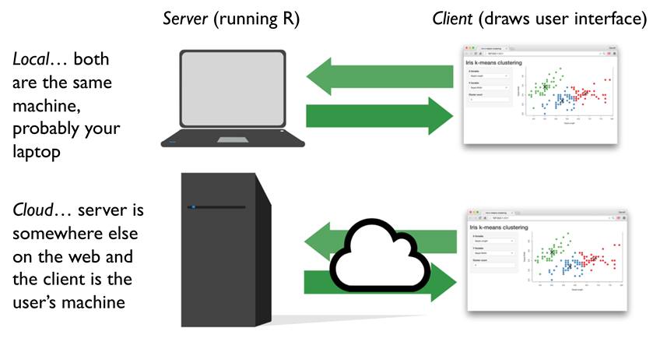
Deployment

Slide 88
Future courses
GitHub for collaboration in health economics
Markdown for health economic reporting
Advanced R-Shiny application deployment
Beautiful visuals for health economics
Discrete Event Simulation for health economics
Microsimulation methods for health economics.

Slide 89
Further resources & Help (General)
R for Data Science: https://r4ds.had.co.nz/
Efficient R Programming: https://csgillespie.github.io/efficientR/
Mastering Shiny: https://mastering-shiny.org/
RMarkdown: https://bookdown.org/yihui/rmarkdown/
…. Medium jump ...
R Packages: https://r-pkgs.org/
…. Huge jump...
Advanced R: https://adv-r.hadley.nz/

Slide 90

We hope you found this course interesting and useful, even online.
To contact Dark Peak Analytics about research collaboration, consultancy or further courses please see our website www.darkpeakanalytics.com or message us at info@darkpeakanalytics.com.
Thanks again for attending,
Rob, Paul & Sarah

Slide 91
Additional Slides

Slide 92
Session 4: Objectives
Creating fancy plots in ggplot (30 mins)
R-Markdown (45 mins)
Customising R-Shiny using CSS/HTML (30 mins)
Warning modals & debugging (30 mins)
Deploying Apps Online (10 mins)
Other questions - code from our open-source.

Slide 93
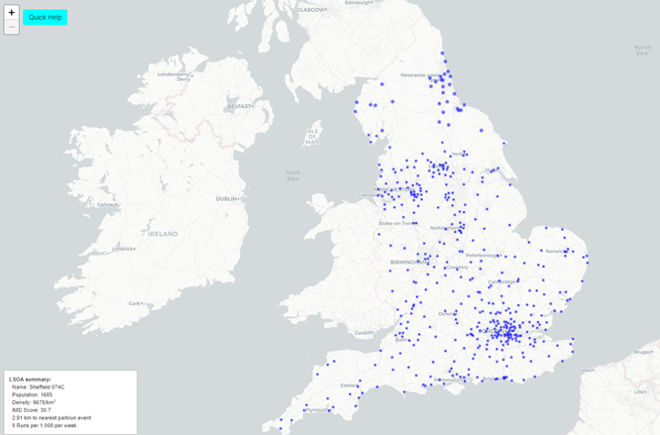
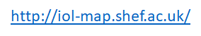
Other Examples

Slide 94

Examples
https://srhr.org/fgmcost/

Slide 97
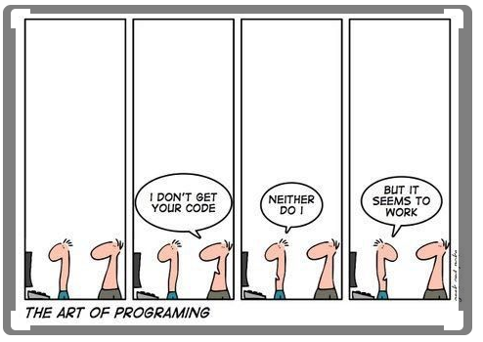
Live coding

Slide 98


Why learn R? – community.

Slide 99
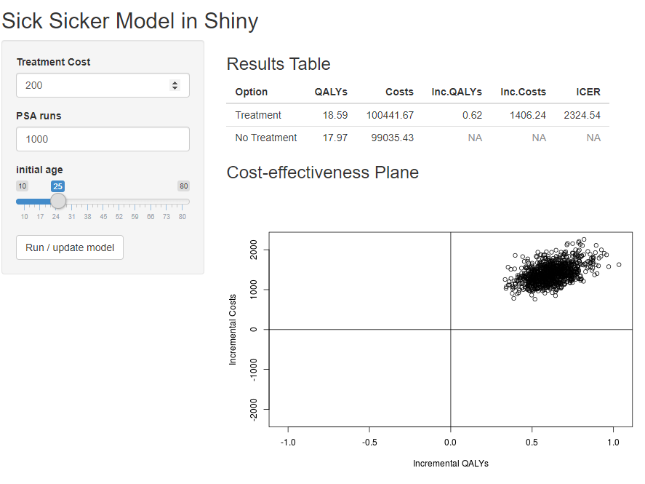
Simple app
https://robertasmith.shinyapps.io/sick_sicker

Slide 100
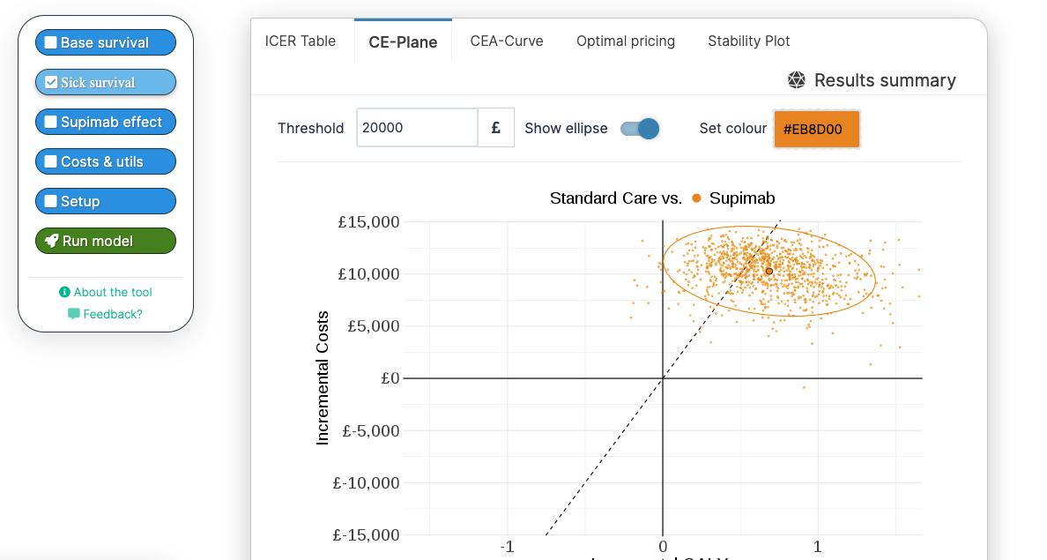
A lean R-Shiny app for a
time-dependent markov model
https://darkpeakanalytics.shinyapps.io/sadm-mk2/

